Slide 1
Containers - You Better Get on Board!
Anthony E. Nocentino
aen@centinosystems.com

Slide 2
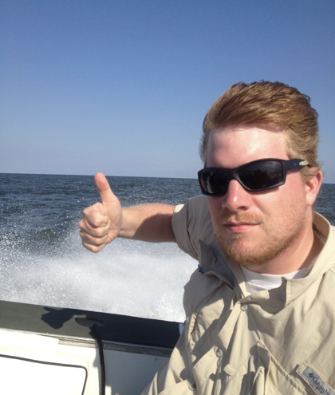
Anthony E. Nocentino
Consultant and Trainer
Founder and President of Centino Systems
Specialize in system architecture and performance
Microsoft MVP – Data Platform – 2017-2020
Friend of Redgate - 2015-2019
Linux Foundation Certified Engineer
Microsoft Certified Professional
email: aen@centinosystems.com
Twitter: @nocentino
Blog: www.centinosystems.com/blog
Pluralsight Author: www.pluralsight.com

Slide 3
Agenda
Introducing Containers
Containerizing Apps and Data Centers
Running SQL Server in Containers
The Container Universe
Hands on with Containers
Container Orchestration
High Availability Container Scenarios

Slide 4
Introducing Containers
Operating system virtualization
Shared kernel and system resources
Container…contain…
Binaries, libraries and file system
One app inside the container
This is the unit of work
Containers are ephemeral
Let’s start off with a comparison…
App1
Binaries/Libraries
Container

Slide 5
Virtual Machines
App1
App2
App3
App4
App5
App6
Guest OS
Guest OS
Guest OS
Hypervisor
High Maintenance
Physical Machine

Slide 6
What’s so Hard About Virtual Machines?
OS Resource Overhead
Patching
Troubleshooting
Upgrades
Deployments
Does any of this move your business forward?
Notes:
Inconsistency of configuration and configuration skew

Slide 7
Containers
App1
App2
App3
Binaries/Libraries
Binaries/Libraries
Binaries/Libraries
Container
Container
Container
Host Operating System
Physical Machine
Lower Maintenance

Slide 8

It’s all about goin’ fast!

Slide 9
What do Containers Bring to the Table?
Fast and Consistent Deployments
Upgrades
Troubleshooting
Patching
Speed
Services, we care about getting work done!
Notes:
Inconsistency of configuration and configuration skew
Less time operating the system, more time selling widgets

Slide 10
Containers
Patching/Deployments/Whatever
App1
App2
App3
Binaries/Libraries
Binaries/Libraries
Binaries/Libraries
Container
Container
Container
Host Operating System
Physical Machine

Slide 11
Containerizing Apps and Data Centers
Reducing development time
Deployment automation – speed and consistency
Enables DevOps and CI/CD scenarios
Orchestration
High availability
Rethink how you deploy - it’s the application service, not the server
Notes:
Anything you do to reduce system overhead and deployment time increases your value to the business
https://blog.docker.com/2017/09/microsoft-sql-on-docker-ee/

Slide 12
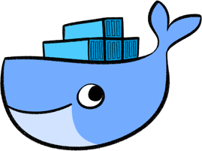
The Container Universe
Docker
Linux
Windows
Mac
Docker Inc.
Other Container Engines
rkt
CoreOS
Windows
chroot…chwhat?

Slide 13
Getting Containers
Images – code, runtimes, libraries, environment variables
Registries – where images live. Docker Hub, Azure Container Registry, internal
Docker Files – defines the container image
App1
Docker File
Binaries/Libraries
App1
Container
Host Operating System
Binaries/Libraries
Registry
Image
Physical Machine
Build!
Push it!
Pull it!
Notes:
https://docs.docker.com/engine/reference/builder/#usage
A container is a running image
Build OR COMMIT

Slide 14
Container Internals
App1
App2
App3
Binaries/Libraries
Binaries/Libraries
Binaries/Libraries
Shared OS
Resource isolation
Namespaces
Process Isolation - PID
File System – MNT
Network – NET
Interprocess Communication - IPC
Kernel Isolation - UTS
Resource governing
cgroups
Union file system
Container
Container
Container
Host Operating System
Physical Machine
Notes:
https://docs.docker.com/engine/docker-overview/#the-underlying-technology

Slide 15
Data Persistency in Containers
But containers are ephemeral, what about my data?

Slide 16
Data Persistency in Containers
If your container is alive so is your data, don’t delete the container
Docker Data Volumes
Docker managed resource
Independent of the container
https://docs.docker.com/storage/
App1
App2
App3
Binaries/Libraries
Binaries/Libraries
Binaries/Libraries
Container
Container
Container
Host Operating System
Physical Machine
vol1
Notes:
https://docs.docker.com/storage/volumes/
https://docs.microsoft.com/en-us/sql/linux/sql-server-linux-configure-docker?view=sql-server-linux-2017#persist

Slide 17
Running SQL Server on Containers
Why run SQL Server on a Container?
Same reasons…
Deployments, upgrades, patching, speed…agility
What if the unit of persistency IS the database…NOT the Server!
Windows and Linux is available
https://github.com/Microsoft/mssql-docker
Non-production on Windows
Production on Linux, but no Windows auth…but that’s OK, right?

Slide 18
Demo!
Pull an Image
Run a Container
Access our application
Connect to the Container
Persisting data with a Container

Slide 19
Container Orchestration
Workload placement
Managing state, starting things up and keeping things up
Load balancing services
Networking
Persistent storage
Declarative model

Slide 20
Container Orchestrators
Docker Swarm
Kubernetes
Red Hat OpenShift
Azure Kubernetes Services (AKS)
Google Kubernetes Engine (GKE)
Amazon Elastic Container Service for Kubernetes (EKS)

Slide 21
Container Orchestration - Services
Cluster
Service1
App1
App2
App3
App1
App2
App3
Binaries/Libraries
Binaries/Libraries
Binaries/Libraries
Binaries/Libraries
Binaries/Libraries
Binaries/Libraries
Container
Container
Container
Container
Container
Container
Host Operating System
Host Operating System
Physical Machine
Physical Machine

Slide 22
Container Orchestration – High Availability
Cluster
Service1
Replica Set
SQL1
SQL1
Binaries/Libraries
Binaries/Libraries
Container
Container
Host Operating System
Host Operating System
Physical Machine
Physical Machine
Persistent Volume
vol1
vol1

Slide 23
Demo!
“Failover cluster” using Kubernetes

Slide 24
What’s Next?
Production?
Drop some Tweets on the Twitters about this session ;)

Slide 25
Review
Introducing Containers
Containerizing Apps and Data Centers
Running SQL Server in Containers
The Container Universe
Hands on with Containers
Container Orchestration
High Availability Container Scenarios

Slide 26
Need more data?
Contact me!
email: aen@centinosystems.com
Twitter: @nocentino
Blog
www.centinosystems.com/blog
Pluralsight
Understanding and Using Enterprise Linux 7
SQL Server on Linux Fundamentals
Kubernetes Installation and Configuration Fundamentals
Managing the Kubernetes API Server and Pods

Slide 27
Resources
Installing Docker
https://docs.docker.com/docker-for-windows/install
https://docs.docker.com/install/linux/docker-ce/centos
Running Docker
https://docs.docker.com/get-started
https://docs.docker.com/storage
https://docs.docker.com/engine/security/security

